Slide 1
Impact of browsing statistics on revenue generation
Developing good predictive models for revenue generation
Presented by: Daniel Zheng and Angeline Ang
Last updated: 15 Apr 2023

Slide 2
Business Problem
Customer visited webpage without purchasing any items.
Data Science Problem
Predict if visitor will buy
gaining insights to improve conversion rates
Notes:
We have been tasked to look into providing recommendations for improving revenue generation, through:
Predicting whether the visitor to the page will buy something

Slide 3
Dataset
Dataset Name: "Online Shoppers Intention"
12,330 observations
18 columns
Source: UCI Machine Learning Repository.
Notes:
Dataset consists of 12,330 observations of customer visits to the website, and 18 columns, with one column representing whether Revenue was generated or not.
Features include web page browsing statistics (eg. Page Values, Duration spent on sites etc.) and other data points such as weekends, months, browsers, operating systems and visitor type.
Source: UCI Machine Learning Repository. https://archive.ics.uci.edu/ml/datasets/Online+Shoppers+Purchasing+Intention+Dataset#

Slide 4
Dataset Description
Columns
Description
Administrative
Administrative Duration
Informational
Informational Duration
Product Related
Product Related Duration
The number of different types of pages visited by the visitor in that session and total time spent in each of these page categories
Bounce Rates
Exit Rates
Page Values
Percentage of visitors who enter the site from that page and then leave ("bounce") without triggering any other requests.
All pageviews to the page, the percentage that were the last in the session.
The average value for a web page that a user visited before completing an e-commerce transaction.
Notes:
The value of "Bounce Rate" feature for a web page refers to the percentage of visitors who enter the site from that page and then leave ("bounce") without triggering any other requests to the analytics server during that session.
The value of "Exit Rate" feature for a specific web page is calculated as for all pageviews to the page, the percentage that were the last in the session.
The "Page Value" feature represents the average value for a web page that a user visited before completing an e-commerce transaction.

Slide 5


Dataset Description
Special Day
The closeness of the site visiting time to a specific special day (e.g., Mother’s Day, Valentine's Day).
Month
All months in a year except January and April
Visitor Type
New visitor or returning visitor
Weekend
Visitor bought during weekend or not
Revenue
Visitor bought items or not
Browser
Region
Traffic Type
Numeric values that indicate different types of browser, region and traffic types

Slide 6



Stakeholders
Customers
Employees
Suppliers

Slide 7
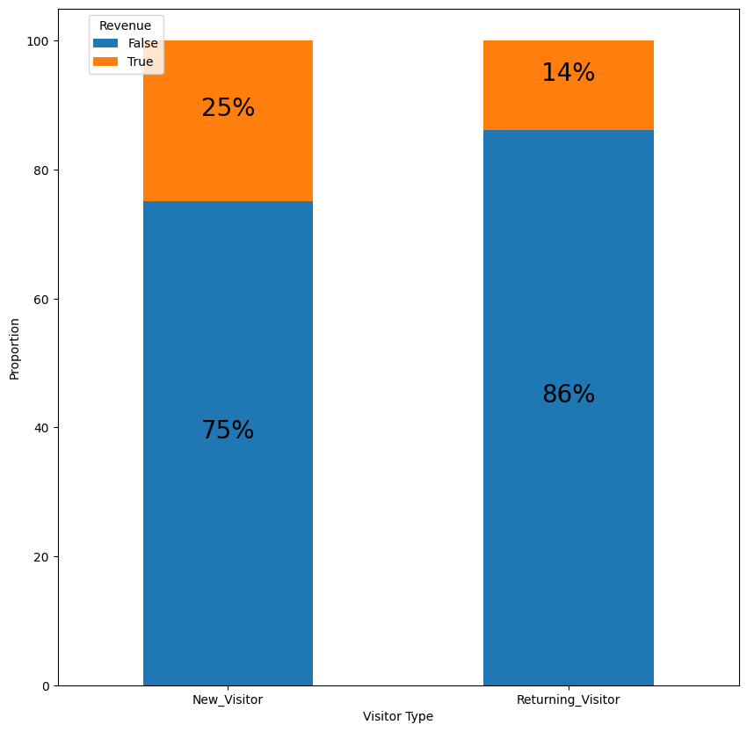
Findings (1) - Revenue based on visitor types
A lower proportion of returning visitors (about 14%) have bought from the site, as compared to newer visitors (about 25%).

Slide 8
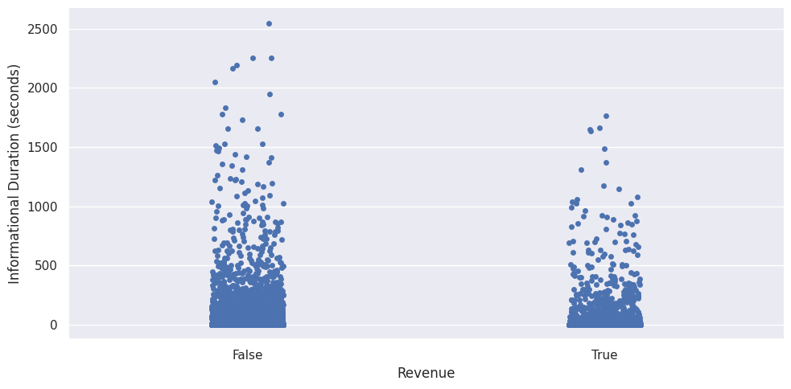
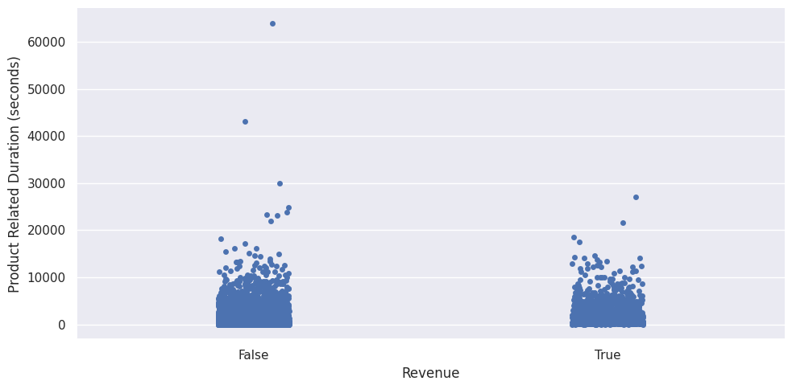
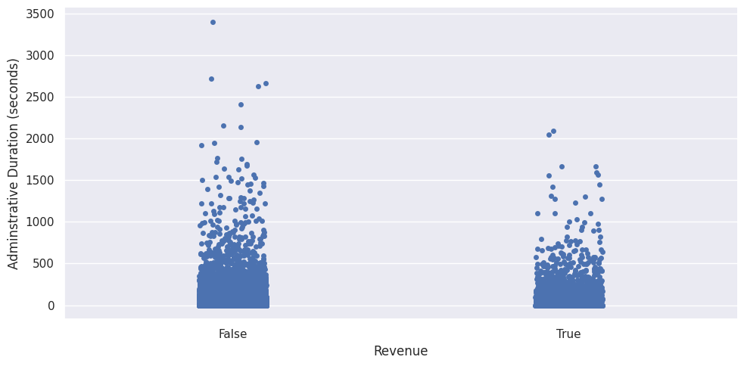
Findings (2) - Duration of different visiting types
These plots shows no clear relation between the time spent on the pages and whether the visitor will buy something as the data points are concentrated towards the bottom for both Revenue labels.

Slide 9
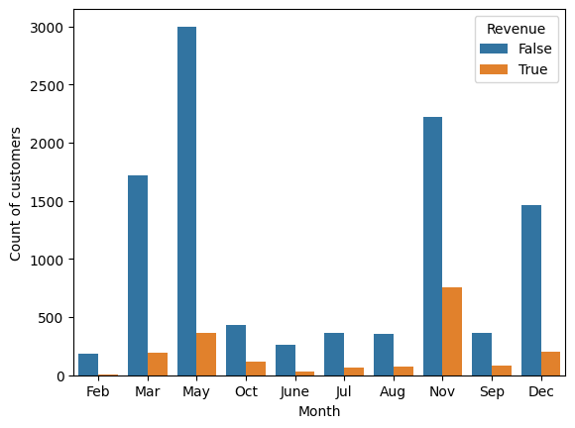
Findings (3) - Revenue generation by months
Throughout the year,the number of visitors who generated revenue is the highest in November.
Conversely, in the month of May, the number of visitors was the highest, but a large proportion of the visitors did not generate revenue.

Slide 10
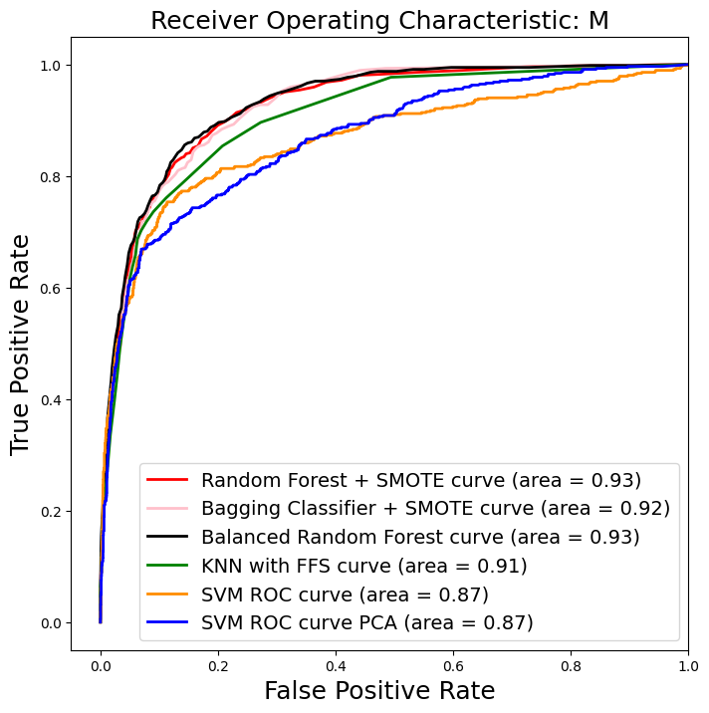
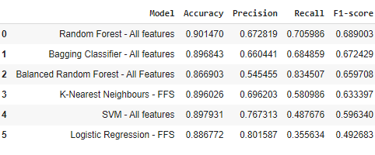
Data Modelling
Random Forest - All Features is the model we have developed for predictions, given that it has the highest F1-score at about 0.69, highest accuracy and recall, and the highest AUC.
Notes:
F1 score
> 0.9
Very good
0.8 - 0.9
Good
0.5 - 0.8
OK
< 0.5
Not good

Slide 11
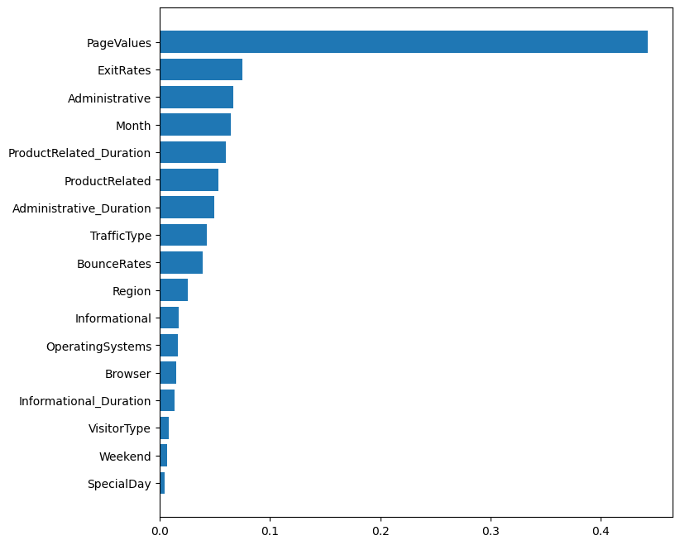
Feature Importance of Random Forest
Based on the Random Forest’s algorithm, Page Values and Exit Rates have the highest feature importance in determining whether the customer buy.
Visitor Type, Weekend, and Special Days have the lowest feature importance.

Slide 12
Recommendations and Conclusion
Develop a loyalty program to entice customers who bought before to come back and buy again (eg. points system that can be used for future purchases, or further discounts for the next purchase)
1
Account for seasonal trends based on months (eg. for Nov, look to maximise revenue via lowering discounts since propensity to buy is higher, while for May, push out more discounts/sales given the high volume of shoppers on the site)
2
Increase conversion rates when customers visit the site, through putting out coupons/discounts to customers who are predicted to not buy on the website
3

Slide 13
Future Work
1
Look further into revenue optimisation by analysing other data points such as:
Types of products sold on the site and their corresponding sale amounts
The type of discounts/loyalty programs that can be provided
2
Potential room for further optimisation of model through feature engineering such as using polynomial features.
3
Develop strategies to increase Page Values, and reduce exit rates from Product Pages

Slide 14
Thank you!
Questions?

